Slide 1
Introduction to NLP
3. Text Classification
Dr. John McCrae
Data Science Institute, University of Galway

Slide 2
Applications of Text Classification

Slide 3
Sentiment Analysis
NLP
this is the most awesome product I have ever seen
😃/🙁

Slide 4
Subject Classification
Is this article about:
In ancient Egypt, cats were worshipped, and the goddess Bastet often depicted in cat form,
Cats?
NLP
Religion?
Art?

Slide 5
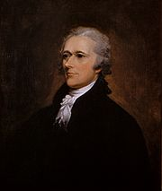
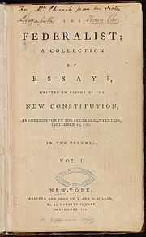
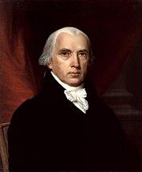
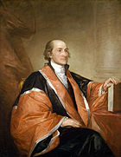
Authorship Identification
?
NLP
?
?
Notes:
Alexander Hamilton, James Madison, John Jay

Slide 6
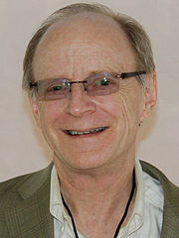
Classification and LIWC
The ways that individuals talk and write provide windows into their emotional and cognitive
worlds... evidence to suggest that people’s physical and mental health can be predicted by the words they use
first-person singular pronouns (e.g., I, me, my) were reliably linked to people’s levels of depression
Common words also useful for many applications!
James W. Pennebaker
Creator of LIWC (Linguistic Inquiry and Word Count)

Slide 7

Suggestion Mining
#alert @NLP_lovers!!
This is the …
Assignment Topic 🤭
I suggest having a sip of water & #pay_extra_attention ;)
Notes:
Emotion analysis usually formulated as Multilabel classification

Slide 8

Suggestions
Opinionated texts may express suggestions for others or for improvement
Often in text segments with neutral sentiment
I suggest to keep a set of normal, macro and telephoto lens
Dear Microsoft, release a new zune with your wp7 launch on the 11th.
Be sure to specify a room at the back of the hotel.
8
Sapna Negi, 2019. Suggestion mining from text (Doctoral dissertation, NUI Galway)

Slide 9
Suggestion Mining
Suggestion Mining comprises:
suggestion classification – binary (y/n) classification of input string
suggestion extraction – span identification of the suggestion
suggestion aspect detection – identify the aspect of the suggestion
suggestions clustering – aggregate similar suggestions together (might include paraphrasing)
10
Sapna Negi, 2019. Suggestion mining from text (Doctoral dissertation, NUI Galway)

Slide 10
Probability in NLP

Slide 11

Probability
The probability of a coin coming up heads is 50%
What does this mean?

Slide 12

Probability
What is the probability that it will rain tomorrow?
What is the probability that it rained yesterday?

Slide 13
Let’s play a game!

Slide 14
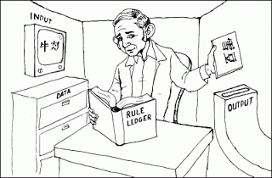
Chinese Room
Computational models of consciousness are not sufficient by themselves for consciousness. The computational model for consciousness stands to consciousness in the same way the computational model of anything stands to the domain being modelled. Nobody supposes that the computational model of rainstorms in London will leave us all wet. But they make the mistake of supposing that the computational model of consciousness is somehow conscious. It is the same mistake in both cases
John R. Searle (2002)
Implication: With incomplete knowledge of the rules, computers should make the best guess!

Slide 15

Probability in NLP
The most likely answer is “雪豆”
If the rules are ‘incomplete’ then we should produce the most likely answer

Slide 16
What is wrong with these statements?
The probability of a coin coming up heads is -1
The probability of a coin coming up heads is 12,345
There is a 60% chance of a coin coming up heads and a 60% chance of it coming up tails

Slide 17
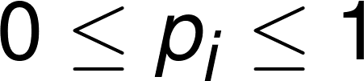
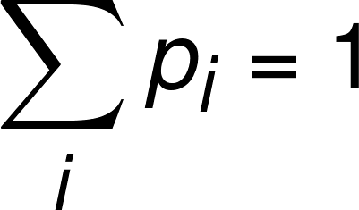
Axioms of Probability

Slide 18
Text Classification
Examples (Part 1)

Slide 19
Bayes’ Law and Naïve Bayes

Slide 20
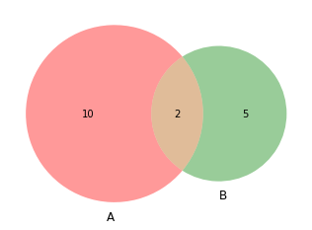
Probability refresher
N=30
What are the following?
P(A)
P(B)
P(B|A)
Define P(B|A)
= 12/30
= 7/30
= 2/12
= P(B∩A)/P(A)

Slide 21
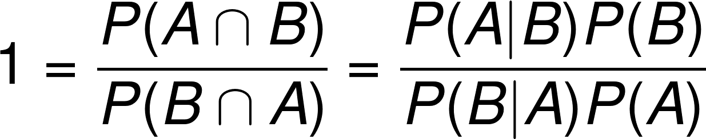
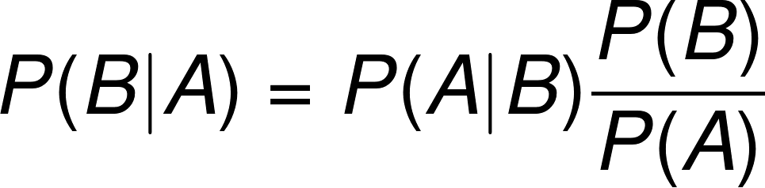
Bayes’ Law
Notes:
P(A\cap B) = P(A|B)P(B) = P(B|A)P(B)
1 = \frac{P(A \cap B)}{P(B \cap A)} = \frac{P(A|B)P(B)}{P(B|A)P(A)}

Slide 22
Features
‘awesome’ in text
NLP
‘great’ in text
😃/🙁
‘awful’ in text

Slide 23
Applying Bayes Law
P(Positive=True | Awesome=True ∩ Great=False ∩ Awful=True)
= P(Pos|F₁∩F₂∩F₃)
= P(F₁∩F₂∩F₃|Pos)✕ P(Pos) ÷ P(F₁∩F₂∩F₃)
P(Pos|F₁∩F₂∩F₃) > P(Neg|F₁∩F₂∩F₃)
⇒ P(F₁∩F₂∩F₃|Pos)✕ P(Pos) ÷ P(F₁∩F₂∩F₃) > P(F₁∩F₂∩F₃|Neg)✕ P(Neg) ÷ P(F₁∩F₂∩F₃)
⇒ P(F₁∩F₂∩F₃|Pos)✕ P(Pos) > P(F₁∩F₂∩F₃|Neg)✕ P(Neg)

Slide 24
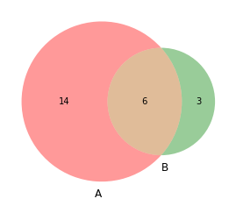
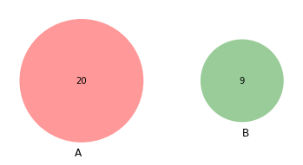
Independence
Two events are independent if P(A∩B)=P(A)P(B)
N=30
Not Independent
Independent

Slide 25
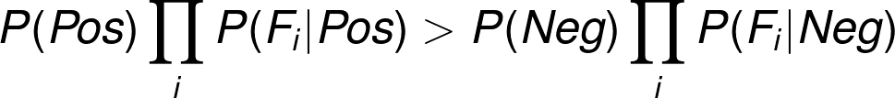
Naïve Bayes
We assume that:
P(F₁∩F₂∩F₃|Pos) = P(F₁|Pos)P(F₂|Pos)P(F₃|Pos)
Hence we wish to calculate

Slide 26
Learning and Evaluating

Slide 27
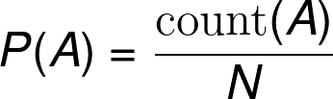
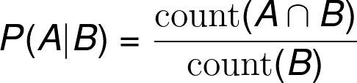
Learning Bayesian Models
Bayesian models can be learned simply through counting
How often do we see A?
Number of times A could occur

Slide 28

Evaluation
You are in a zombie apocalypse
10% of your group (N=100) are infected
Your test for being a zombie is 90% effective
If you kill everyone who tests positive
How many zombies do you miss?
How many non-zombies do you kill?

Slide 29
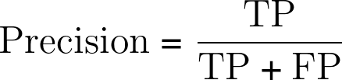
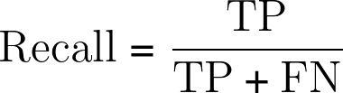
Precision, Recall
True Positive
False Negative
 | Positive Test | Negative Test
Zombie | 9 | 1
Citizen | 9 | 81
Precision = 0.5
Recall = 0.9
False Positive
True Negative

Slide 30
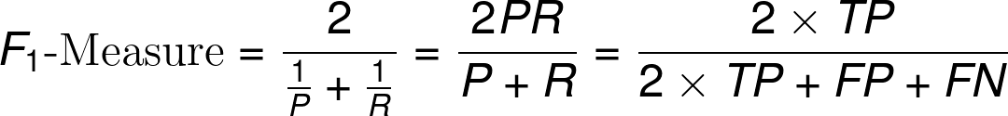
F-Measure
We would like to combine precision and recall
We can always achieve 100% recall or 100% precision… how?
Always predict true or false
So we can’t just use mean of precision and recall
Instead we use the harmonic mean

Slide 31
F-Measure
There is a generalization of F-Measure called F_{β}-Measure that balances between precision and recall
Either P ≤ FM ≤ R or R ≤ FM ≤ P
If P=0 or R=0 then FM=0

Slide 32
Text Classification
Examples (Part 2)

Slide 33
Improving Text Classification

Slide 34
Stopwords
High frequency words are often not useful
They occur in all documents
Most applications don’t need them
We can manually remove them (stopword removal)

Slide 35
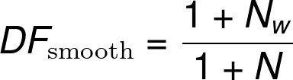
Document Frequency
Document frequency is the proportion of documents that contain a word
How can we use this to weight common terms?
Number of documents containing w
Total number of documents

Slide 36
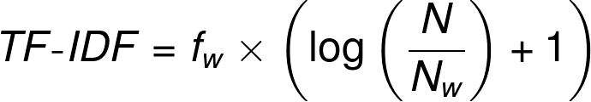
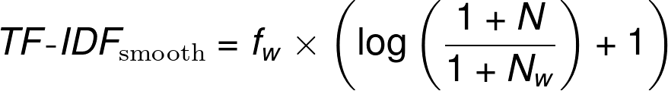
TF-IDF
This is often combined into a single score
TF-IDF = Term Frequency Inverse Document Frequency
Occurrences of w in current document
Note: There are a lot of variants of TF-IDF, these are the two implemented by SciKit Learn
Notes:
TF\text{-}IDF=f_w \times \left( \log\left\(\frac{N}{N_w}\right) + 1\right)

Slide 37
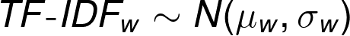
TF-IDF and Naïve Bayes
TF-IDF can be used in Naïve Bayes by assuming it follows a probability distribution, e.g.,
More generally TF-IDF can be used with other classifiers (see your ML course)
Support Vector Machine
Perceptron
etc.

Slide 38
Out of Vocabulary Items
There are many words we see only on the test data
How to solve this?
Get a bigger corpus!
Not always possible
More complex probabilities require exponentially larger corpora

Slide 39
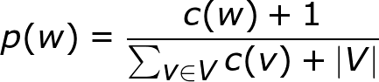
Add-one smoothing
Simple idea: add one to every count

Slide 40
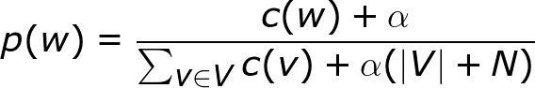
Problems with add one smoothing
Not a probability distribution with OOV as does not sum to one
Overestimates low probabilities and underestimates frequent probabilities
Laplace smoothing (or add alpha) has two parameters:
α, the amount to add
N, the expected number of OOV
It is not clear how to find α or N

Slide 41
Exercise Sheet
Text classification with TF-IDF and Support Vector Machines
Interested in a PhD?
Talk to me
GOIPG Deadline: 20th Oct

Slide 42
Questions?

